Slide 1

The Perfect Vacation
A model to predict the rate of Airbnb’s rental apartment

Slide 2

Introduction
Background
As most of us were abroad, we all know that one of the biggest dilemmas is deciding what is the best place to stay in during our vacation?
In this project we will try to supply an ML model which predicting the rate of giving apartments, based on some of the apartment’s features.

Slide 3


External Resources
Airbnb

Slide 4

Apartment page example
Example of rental apartment page as It show in Airbnb’s website.
We can see the yellow marks which is part of the main features we want to extract for each page

Slide 5

Stage 1: data acquisition
Crawling
using BeautifulSoup & Requests & Pandas
Extract all apartments information from various cities in USA
Extract :
Location
Name
Number of rooms
Max guest
Binary features (Pets, Wifi, TV, Cooling, Heating etc.)
Price
Review counts
Total rate

Slide 6
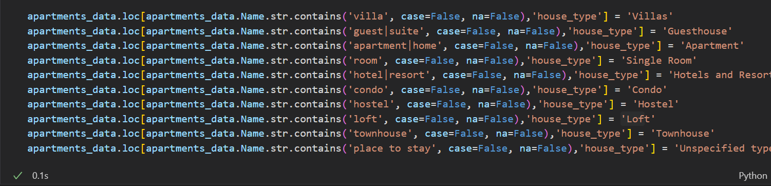
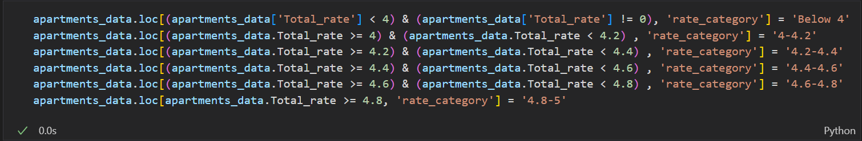
Stage 2: New Features Creation
For future use, we have created 2 new features in our dataset:
“house_type” feature
2. “rate_category” feature

Slide 7

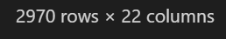
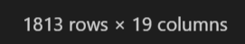
Stage 3: Data cleanup
Binary classification of all True/False attributes
Checking and removing duplicates
Filtering irrelevant features and records
Handle missing values in our dataset

Slide 8
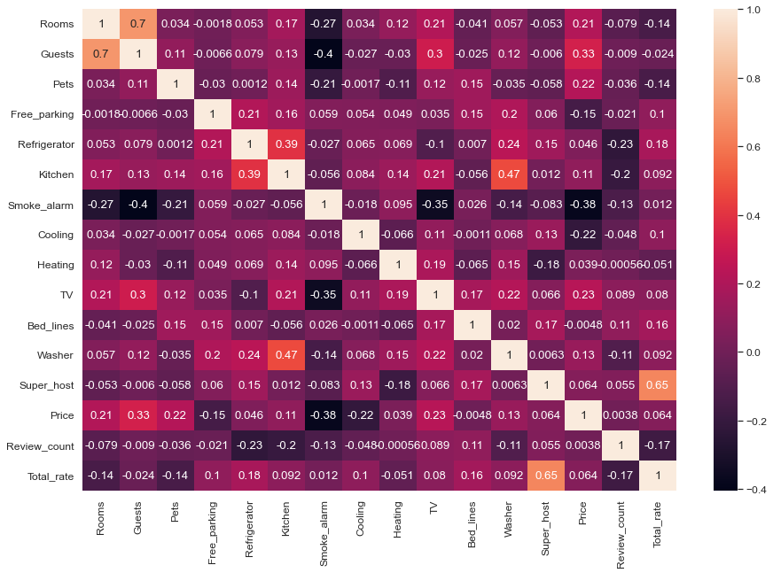
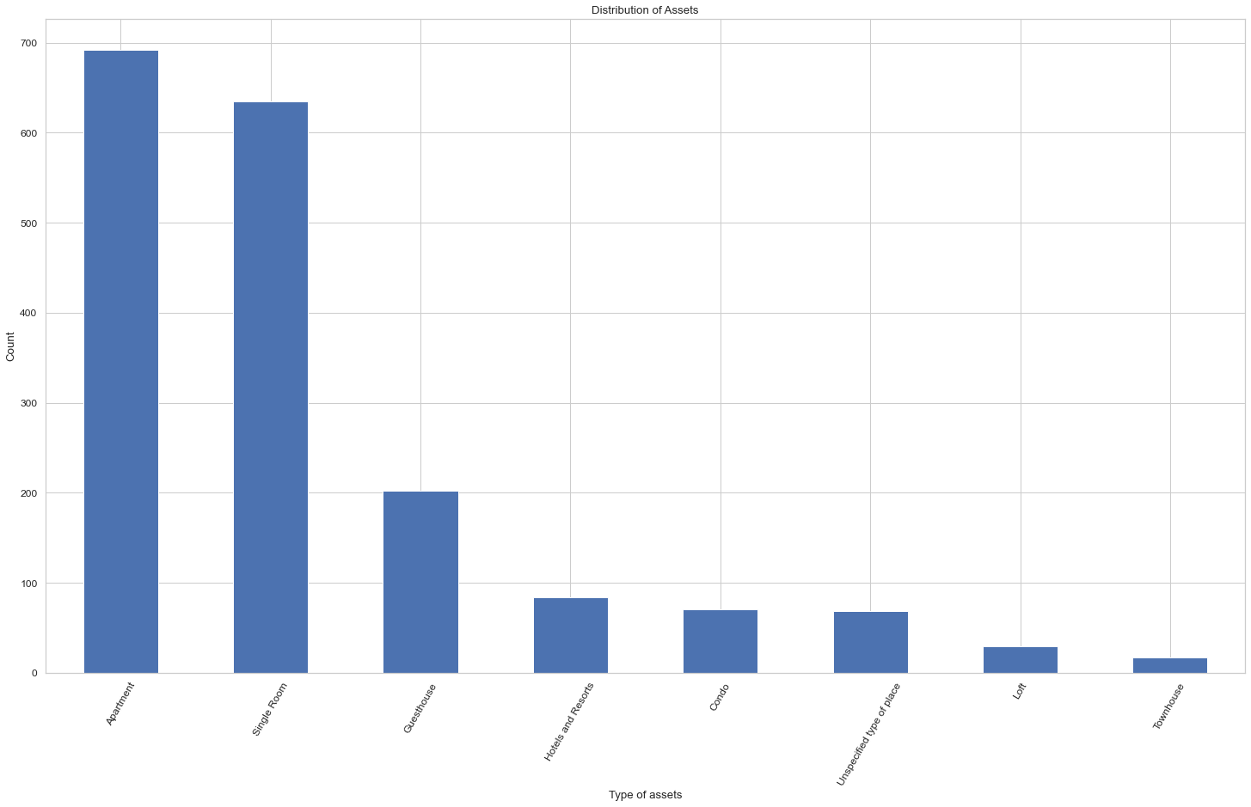
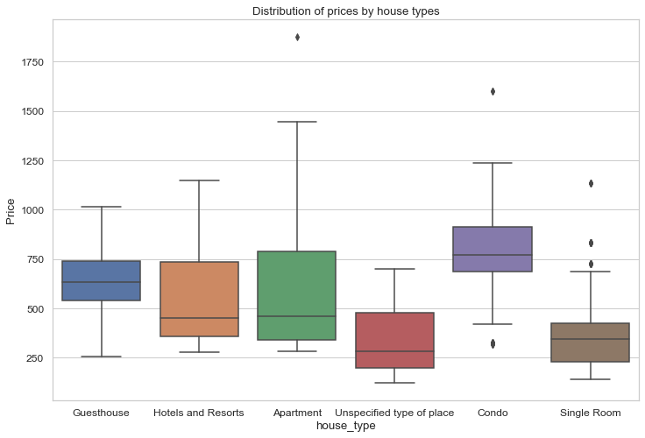
Stage 4: EDA & Visualization
We’ve created some charts and plot in order to understand the data better
Heatmap
Barplot
Boxplot

Slide 9
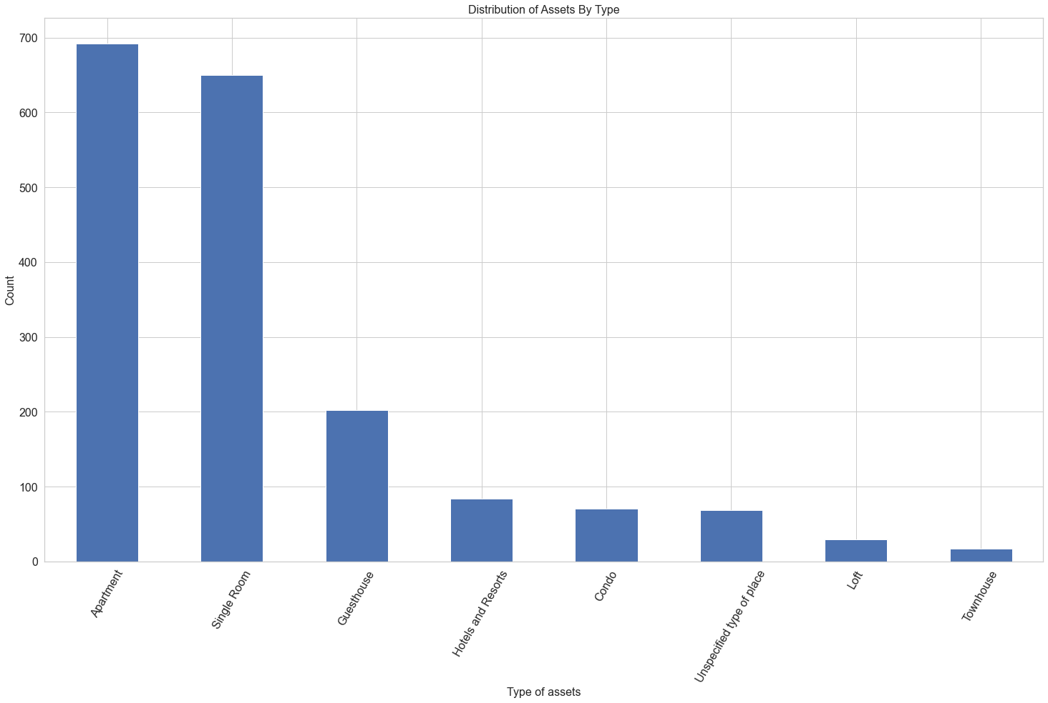
EDA & Visualization

Slide 10
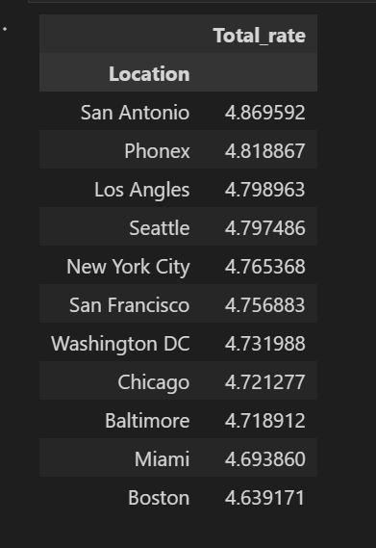
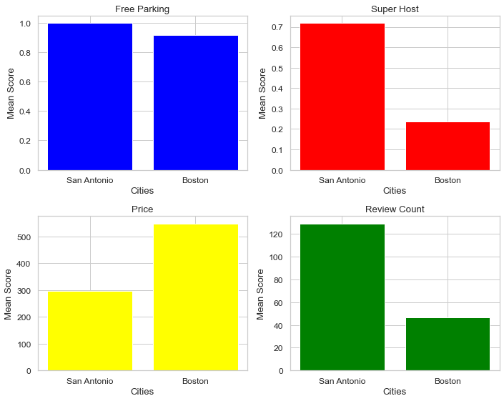
EDA & Visualization

Slide 11

Stage 5: Machine learning
Our Machine Learning question:
Can we predict Airbnb’s apartment rate based on pre-defined attributes and make our vacation a successful experience?
In order to try and answer this question we have used 2 machine learning methods:
Linear Regression
KNN

Slide 12
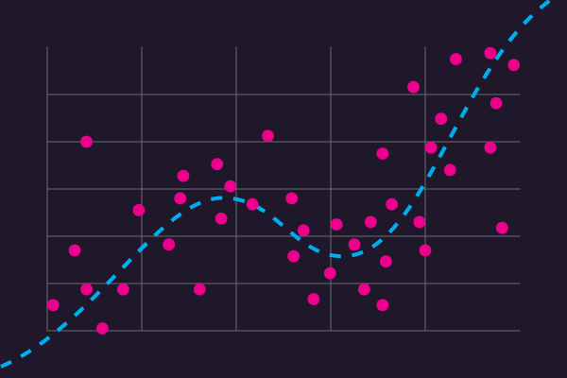
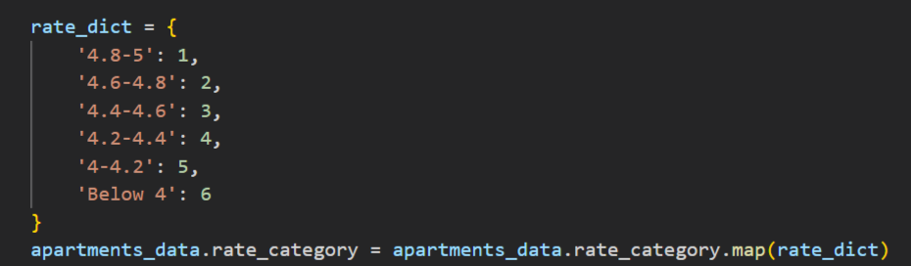
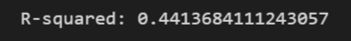
Linear Regression
Our first machine learning method was linear regression.
We used the ‘rate_category` column as our target column and change the different rate categories to scale from 1 to 6
Unfortunately, we got score of 0.44, which is not good enough for us.

Slide 13
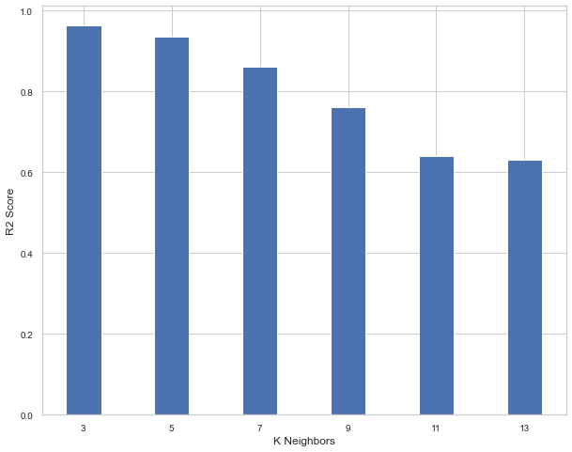
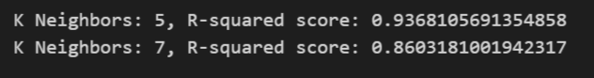
KNN
When we used KNN method, we noticed that our prediction results was much better.
We’ve used different K values (between 3 to 13), and notice that when K value increased the R-squared score decreased.
According to the results we got, the optimal K value for us was 5 or 7, which gave us success rate of more than 86%

Slide 14
Conclusion
Our research question was trying to predict Airbnb’s apartment rate based on pre-defined features
We’ve tried to reach our goal by using different machine learning models and get the best prediction results
We have reached out that linear regression method with our existing dataset and its features didn’t gave us the result we want to achieve
With KNN we got accuracy rate of more than 86% (depends on K value we chose) and we can determine the asset score based on our defined features

Slide 15
Thank you for listening!

